Slide 1
System of Linear Equations
Iterative method for solving system of linear equations Jacobi Iteration

Slide 2
Content
History, Problem and Objective
Derivation of Formula (Equation and Matrix Form)
Assumptions of Jacobi Iterations
Iteration Process Example
Advantages and Disadvantages of Jacobi Iterations
Error Analysis
Real Life Application

Slide 3
History, Problem and Objective
History (https://archive.siam.org/meetings/la09/talks/benzi.pdf)
This method is named after Carl Gustav Jacob Jacobi
In 1845 Jacobi introduced his own iterative method, again for solving normal equations for least squares problems (statistical regression analysis) arising in astronomical calculations
Problem: Solving a system of linear equations
Objective: Using Jacobi Iteration in order to approximate the values of each unknown in a system of linear equations
Required Skills:
Rearrangement of equation by changing the subject of the equation
Matrix (Diagonal Matrix, Inverse Diagonal Matrix, Lower and Upper Triangular Matrix)

Slide 4
Derivation of Jacobi Iteration

Slide 5

Derivation Of Jacobi Iteration Formula (Equation)
$a_{11}x_{1}+a_{12}x_{2}+…$ $a_{1n}x_{n}=b_{1}$ $a_{21}x_{1}+a_{22}x_{2}+… a_{2n}x_{n}=b_{2}$ $⋮$ $a_{n1}x_{1}+a_{n2}x_{2}+… {+a_{nn−1}x_{n−1}+a}_{nn}x_{n}=b_{n}$ (2nd last term is $a_{nn−1}x_{n−1}$)
Solve for $x_{1}$ for the first equation$, x_{2}$ for the second equation, $x_{n}$ for the $n$ th equation:
$x_{1}=\frac{1}{a_{11}}(b_{1}−$ $a_{12}x_{2}− … −a_{1n}x_{n})$ $x_{2}=\frac{1}{a_{22}}\left(b_{2}− a_{21}x_{1}− … −a_{2n}x_{n}\right)$ $⋮$ $x_{n}=\frac{1}{a_{nn}}(b_{n}− a_{n1}x_{1}− … −a_{nn−1}x_{n−1})$

Slide 6

Derivation Of Jacobi Iteration Formula (Equation)
Make an initial guess just like in fixed point iteration, rather this is a matrix ($x_{1}^{ (0)},x_{2}^{ (0)}, …x_{n}^{ (0)})$these values of into the RHS of the equation to obtain ($x_{1}^{ (1)},x_{2}^{ (1)}, …x_{n}^{ (1)})$
$x_{1}^{ (k+1)}=\frac{1}{a_{11}}(b_{1}−$ $a_{12}x_{1}^{ (k)}− … −a_{1n}x_{n}^{ (k)})$ $x_{2}^{ (k+1)}=\frac{1}{a_{22}}\left(b_{2}− a_{21}x_{1}^{ (k)}− … −a_{2n}x_{n}^{ (k)}\right)$ $⋮$ $x_{n}^{ (k+1)}=\frac{1}{a_{nn}}(b_{n}− a_{n1}x_{1}^{ (k)}− … −a_{nn−1}x_{n−1}^{ (k)})$
One iteration process is completed, the new values of $x_{i}^{ }$ will be then used again for the next iteration

Slide 7

Derivation Of Jacobi Iteration Formula (Matrix)
Note: This Would Require Fundamentals of Matrix
Recall: $Ax=b$ Where:
$A$ is a matrix with dimension of $(n × n)$, a square matrix (must)
$A=$ $\left[\begin{matrix}a_{11} & a_{12} & ⋯ & a_{1n} \\ a_{21} & a_{22} & ⋯ & a_{2n} \\ ⋮ & ⋮ & ⋱ & ⋮ \\ a_{n1} & a_{n2} & ⋯ & a_{nn}\end{matrix}\right]$ $x=\left[\begin{aligned}x_{1} \\ ⋮ \\ ⋮ \\ x_{n}\end{aligned}\right]$ $b= \left[\begin{aligned}b_{1} \\ ⋮ \\ ⋮ \\ b_{n}\end{aligned}\right]$

Slide 8

Derivation Of Jacobi Iteration Formula (Matrix)
Solving For $x$:
$$Ax=b \\ \left(A^{−1}A\right)x=A^{−1}b \\ x=A^{−1}b$$
Expanding/Rewriting Matrix $A$
$$Ax=b \\ \left(D+[L+U]\right)x=b \\ Dx=b−\left[L+U\right]x \\ D^{−1}Dx=D^{−1}\left(b−\left[L+U\right]x\right) \\ x_{new}= D^{−1}(b −\left[L+U\right]x_{old})$$
Where $D$ is the matrix containing only diagonal values of matrix A $L$ is the lower triangular matrix and $U$ is the upper triangular matrix $D^{−1}$ is the inverse matrix of D, inversing a diagonal matrix is done by finding reciprocal of each diagonal element
$D=\left[\begin{matrix}a_{11} & 0 & ⋯ & 0 \\ 0 & a_{22} & ⋯ & 0 \\ ⋮ & ⋮ & ⋱ & ⋮ \\ 0 & 0 & ⋯ & a_{nn}\end{matrix}\right]$ $[L+U]= \left[\begin{matrix}0 & a_{12} & ⋯ & a_{1n} \\ a_{21} & 0 & ⋯ & a_{2n} \\ ⋮ & ⋮ & ⋱ & ⋮ \\ a_{n1} & a_{n2} & ⋯ & 0\end{matrix}\right]$ $D^{−1}=\left[\begin{matrix}\frac{1}{a_{11}} & 0 & ⋯ & 0 \\ 0 & \frac{1}{a_{22}} & ⋯ & 0 \\ ⋮ & ⋮ & ⋱ & ⋮ \\ 0 & 0 & ⋯ & \frac{1}{a_{nn}}\end{matrix}\right]$

Slide 9




Visual Of Solving Matrix
$$\left(D+[L+U]\right)x=b \\ Dx=b−\left[L+U\right]x \\ x_{new}= D^{−1}(b −\left[L+U\right]x_{old})$$
$\left(\left[\begin{matrix}a_{11} & 0 & ⋯ & 0 \\ 0 & a_{22} & ⋯ & 0 \\ ⋮ & ⋮ & ⋱ & ⋮ \\ 0 & 0 & ⋯ & a_{nn}\end{matrix}\right]+\left[\begin{matrix}0 & a_{12} & ⋯ & a_{1n} \\ a_{21} & 0 & ⋯ & a_{2n} \\ ⋮ & ⋮ & ⋱ & ⋮ \\ a_{n1} & a_{n2} & ⋯ & 0\end{matrix}\right]\right)\left[\begin{aligned}x_{1} \\ ⋮ \\ ⋮ \\ x_{n}\end{aligned}\right]=$ $\left[\begin{aligned}b_{1} \\ ⋮ \\ ⋮ \\ b_{n}\end{aligned}\right]$
$\left[\begin{matrix}a_{11} & 0 & ⋯ & 0 \\ 0 & a_{22} & ⋯ & 0 \\ ⋮ & ⋮ & ⋱ & ⋮ \\ 0 & 0 & ⋯ & a_{nn}\end{matrix}\right]\left[\begin{aligned}x_{1} \\ ⋮ \\ ⋮ \\ x_{n}\end{aligned}\right]=$ $\left[\begin{aligned}b_{1} \\ ⋮ \\ ⋮ \\ b_{n}\end{aligned}\right]−\left[\begin{matrix}0 & a_{12} & ⋯ & a_{1n} \\ a_{21} & 0 & ⋯ & a_{2n} \\ ⋮ & ⋮ & ⋱ & ⋮ \\ a_{n1} & a_{n2} & ⋯ & 0\end{matrix}\right]\left[\begin{aligned}x_{1} \\ ⋮ \\ ⋮ \\ x_{n}\end{aligned}\right]$
$\left[\begin{aligned}x_{1(new)} \\ ⋮ \\ ⋮ \\ x_{n(new)}\end{aligned}\right]=$ $\left[\begin{matrix}\frac{1}{a_{11}} & 0 & ⋯ & 0 \\ 0 & \frac{1}{a_{22}} & ⋯ & 0 \\ ⋮ & ⋮ & ⋱ & ⋮ \\ 0 & 0 & ⋯ & \frac{1}{a_{nn}}\end{matrix}\right]\left(\left[\begin{aligned}b_{1} \\ ⋮ \\ ⋮ \\ b_{n}\end{aligned}\right]−\left[\begin{matrix}0 & a_{12} & ⋯ & a_{1n} \\ a_{21} & 0 & ⋯ & a_{2n} \\ ⋮ & ⋮ & ⋱ & ⋮ \\ a_{n1} & a_{n2} & ⋯ & 0\end{matrix}\right]\left[\begin{aligned}x_{1(old)} \\ ⋮ \\ ⋮ \\ x_{n(old)}\end{aligned}\right]\right)$

Slide 10
Assumption in Jacobi Iteration

Slide 11

Assumption of Jacobi Iteration
Assumption 1 (Only One Unique Solution)
A system of equations can have
No Solution
Infinite Solutions
One Unique Solution
Is it assumed that only ONE unique solution exist in the given system of equations
*Can be checked using the determinant of matrix where $\det\left(A\right)≠0$ implies there exist a unique solution

Slide 12

Assumption of Jacobi Iteration
Assumption 2 (Coefficient of Main Diagonal $≠0$)
Equation form example $a_{11}x_{1}+a_{12}x_{2}+…$ $a_{1n}x_{n}=b_{1}$ $x_{1}=\frac{1}{a_{11}}(b_{1}− a_{12}x_{2}− … −a_{1n}x_{n})$ If coefficient of $x_{1}$ is $0$, in this case $a_{11}=0$, you cannot solve for the value of $x_{1}$ since: $\frac{1}{a_{11}}=\frac{1}{0}=undefined$
To solve this issue, swap the equation positions until the main diagonal does not have a coefficient of $0$ Placing it into matrix and doing row swapping would be easier to see

Slide 13
Iteration Process Example

Slide 14



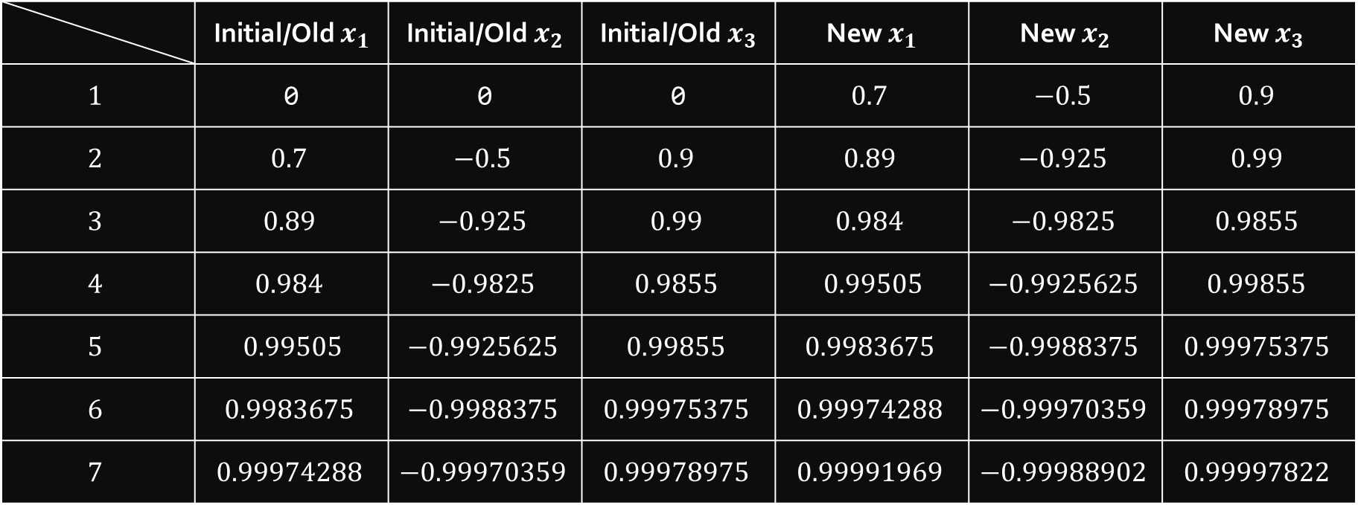



Question (From Lecture Notes)
$$10x_{1}+2x_{2} −x_{3}=7$$
$$x_{1}=\frac{1}{10}(7−2x_{2} +x_{3})$$
$$x_{1}+8x_{2} +{3x}_{3}=−4$$
$$x_{2}=\frac{1}{8}(−4−x_{1} −{3x}_{3})$$
$$−2x_{1}−x_{2} +{10x}_{3}=9$$
$$x_{3}=\frac{1}{10}(9+{2x}_{1} +x_{2})$$
Initial Guess = $\left[\begin{matrix}0 & 0 & 0\end{matrix}\right]$
$epsilon$ (Convergence Tolerance) $= 0.001$, $norm of (x_{new}−x_{old})<epsilon$
 | Initial/Old $x_{1}$ | Initial/Old$x_{2}$ | Initial/Old$x_{3}$ | New $x_{1}$ | New$x_{2}$ | New$x_{3}$
$$1$$ | 0 | 0 | 0 | $$0.7$$ | $$−0.5$$ | $$0.9$$
$$2$$ | $$0.7$$ | $$−0.5$$ | $$0.9$$ | $$0.89$$ | $$−0.925$$ | $$0.99$$
$$3$$ | $$0.89$$ | $$−0.925$$ | $$0.99$$ | $$0.984$$ | $$−0.9825$$ | $$0.9855$$
$$4$$ | $$0.984$$ | $$−0.9825$$ | $$0.9855$$ | $$0.99505$$ | $$−0.9925625$$ | $$0.99855$$
$$5$$ | $$0.99505$$ | $$−0.9925625$$ | $$0.99855$$ | $$0.9983675$$ | $$−0.9988375$$ | $$0.99975375$$
$$6$$ | $$0.9983675$$ | $$−0.9988375$$ | $$0.99975375$$ | $$0.99974288$$ | $$−0.99970359$$ | $$0.99978975$$
$$7$$ | $$0.99974288$$ | $$−0.99970359$$ | $$0.99978975$$ | $$0.99991969$$ | $$−0.99988902$$ | $$0.99997822$$
$$x_{n}$$
Iteration, $n$

Slide 15

Conclusion
Frobenius Norm of Matrix of the final $\left(x_{new}−x_{old}\right)$ $$\sqrt{{(0.99991969−0.99974288 )}^{2}+ ({−0.99988902−(−0.99970359))}^{2}+({0.99997822−0.99978975 )}^{2}}$$ $=0.000328431<0.001$
$x_{1}≈$ $0.99991969$
$x_{2}≈−0.99988902$
$x_{3}≈0.99997822$
Computed $b_{1}, b_{2} and b_{3}$ with the values of $x_{1}$, $x_{2}$, $x_{3}$ (actual values shown in bracket)
$10x_{1}+2x_{2} −x_{3}$ $= 6.99944069 \left(7\right)$
$x_{1}+8x_{2} +{3x}_{3}=−3.99925778 (−4)$
$−2x_{1}−x_{2} +{10x}_{3}=8.99983178 (9)$
Actual Solution: $x_{1}=1$ , $x_{2}=−1$ , $x_{3}=1$

Slide 16
Advantages and Disadvantages

Slide 17

http://fulviofrisone.com/attachments/article/520/9280721.pdf
Advantages
Disadvantages
Jacobi method is the simplest method for approximating a solution for a system of linear equations
Only an initial guess is required to iterate, rather than having to do elementary matrix operation which can be time consuming if it’s a bigger matrix:
Swapping rows
Multiply a row by a non-zero number and add the result to another row
If matrix $A$ is strictly row diagonally dominant (next slide), then the Jacobi method converges for any initial guess
Converges slower than Gauss-Seidel iteration
Only works for square matrix (number of unknowns = number of equations)
Iteration MAY diverge if the matrix is not Diagonally or Strictly Diagonally Dominant. Note: Diagonal Dominance is only a SUFFICIENT condition (just enough) but NOT NECESSARY condition (not a must) for a convergence.
http://www.math.iit.edu/~fass/477577_Chapter_13.pdf

Slide 18

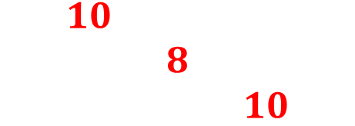
Example Of Diagonally Dominant Matrix
$$\left[\begin{matrix}10 & 2 & −1 \\ 1 & 8 & 3 \\ −2 & −1 & 10\end{matrix}\right]$$
Row $1$: $\left|10\right|≥\left|2\right|+\left|−1\right|$
Row $2$: $\left|8\right|≥\left|1\right|+\left|3\right|$
Row $3$: $\left|10\right|≥\left|−2\right|+\left|−1\right|$
Strictly Diagonally Dominant if the sign is changed from $≥$ to $>$ The iteration will converge for any given initial guess
Row $1$: $10>3$
Row $2$: $8>4$
Row $3$: $10>3$

Slide 19
Error Analysis

Slide 20

Error Analysis
https://ece.uwaterloo.ca/~dwharder/NumericalAnalysis/04LinearAlgebra/jacobi/
The Jacobi method will converge for diagonally dominant matrices; however, the rate of convergence will depend on the norm (Frobenius norm) of the matrix $||D^{−1}M_{off}||$
For a matrix which is diagonally dominant, then $||D^{−1}M_{off}|| <(||D^{−1}||)(||M_{off}||)< 1$ (Calculation on the next slide)
$$\sqrt{\frac{41}{160}}<\left(\sqrt{\frac{57}{1600}}\right)\left(\sqrt{20}\right)<1$$ $$0.5062114183<0.8440971508<1$$

Slide 21


Error Analysis
$D^{−1}=\left[\begin{matrix}\frac{1}{10} & 0 & 0 \\ 0 & \frac{1}{8} & 0 \\ 0 & 0 & \frac{1}{10}\end{matrix}\right]$ $M_{off}=\left[\begin{matrix}0 & 2 & −1 \\ 1 & 0 & 3 \\ −2 & −1 & 0\end{matrix}\right]$ $D^{−1}M_{off}=\left[\begin{matrix}0 & \frac{1}{5} & −\frac{1}{10} \\ \frac{1}{8} & 0 & \frac{3}{8} \\ −\frac{1}{5} & −\frac{1}{10} & 0\end{matrix}\right]$
$${||D}^{−1}||=\sqrt{{\left(\frac{1}{10}\right)}^{2}+{\left(\frac{1}{8}\right)}^{2}+{\left(\frac{1}{10}\right)}^{2}}=\sqrt{\frac{57}{1600}}$$
$$\left|\left|M_{off}\right|\right|=\sqrt{{(2)}^{2}+{\left(−1\right)}^{2}+{\left(1\right)}^{2}+{\left(3\right)}^{2}+{\left(−2\right)}^{2}+{\left(−1\right)}^{2}}=\sqrt{20}$$
$$\left|\left|D^{−1}M_{off}\right|\right|=\sqrt{{\left(\frac{1}{5}\right)}^{2}+{\left(−\frac{1}{10}\right)}^{2}+{\left(\frac{1}{8}\right)}^{2}+{\left(\frac{3}{8}\right)}^{2}+{\left(−\frac{1}{5}\right)}^{2}+{\left(−\frac{1}{10}\right)}^{2}}=\sqrt{\frac{41}{160}}$$

Slide 22


Absolute and Relative Error
Absolute Error
Relative Error
For $x_{1}:$ $|1−0.99991969|$
For $x_{2}:$ $|−1−(−0.99988902)|$
For $x_{3}:$ $|1−0.99997822|$
For $x_{1}:$ $\frac{\left|1−0.99991969\right|}{|1|}\left(100\%\right)=0.008031\%$
For $x_{2}:$ $\frac{\left|−1−\left(−0.99988902\right)\right|}{\left|−1\right|}\left(100\%\right)=0.011098\%$
For $x_{3}:$ $\frac{\left|1−0.99997822\right|}{\left|1\right|}\left(100\%\right)=0.002178\%$

Slide 23
Real Life Application Computing Internal Member Forces in a Bridge Truss Using Classical Iterative Numerical Methods

Slide 24
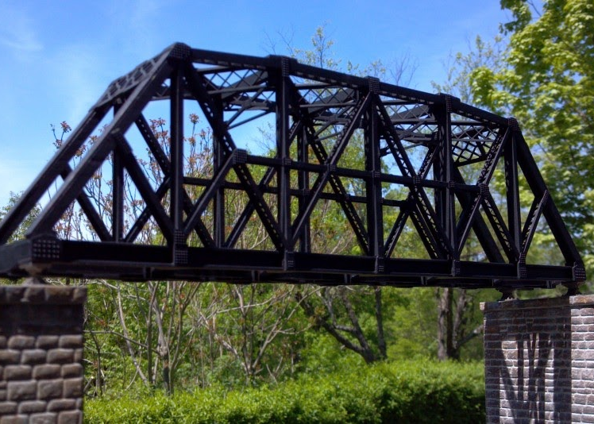
Truss Bridge
A real life truss bridge

Slide 25
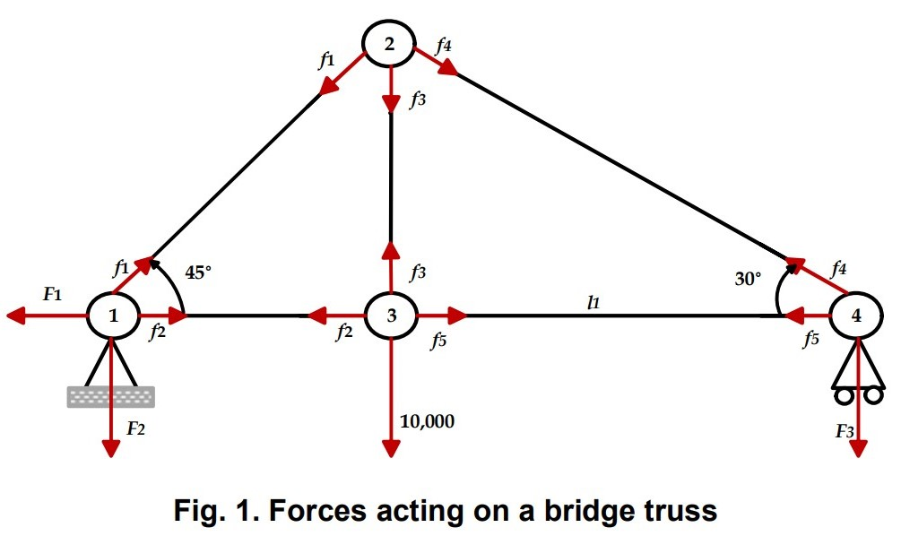
Simplified Model (In Equilibrium)

Slide 26
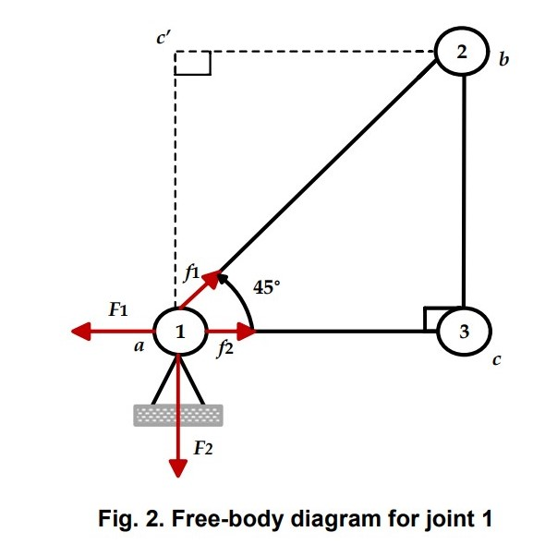
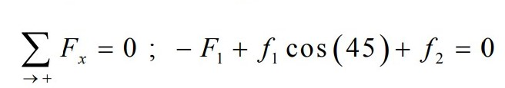

Joint 1 (Resolution of Forces)
Force is a Vector
Forces downward and to the left are taken as negative
Forces upward and to the right are taken as positive

Slide 27
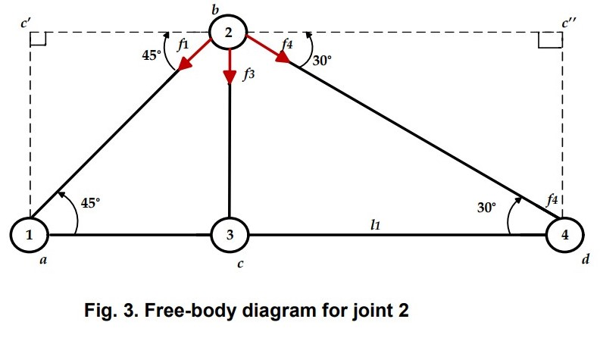
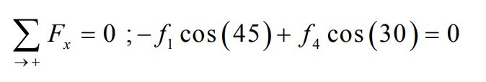
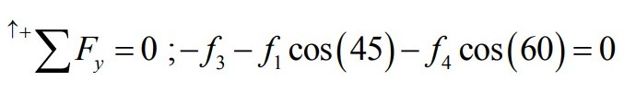
Joint 2 (Resolution of Forces)

Slide 28
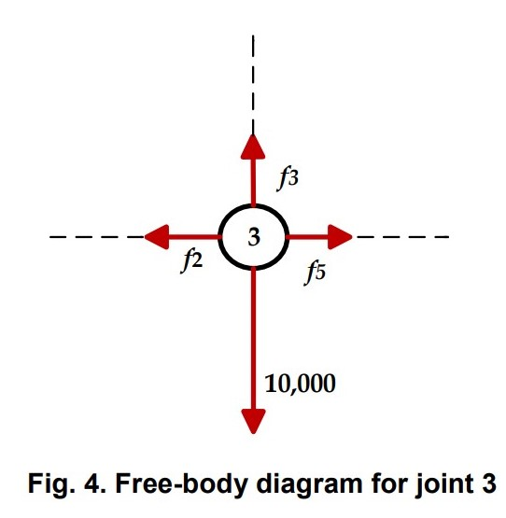
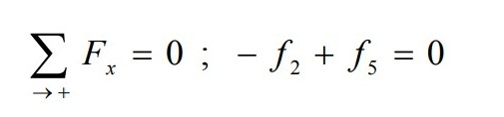
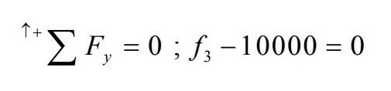
Joint 3 (Resolution of Forces)
Force is a Vector
Forces downward and to the left are taken as negative
Forces upward and to the right are taken as positive

Slide 29
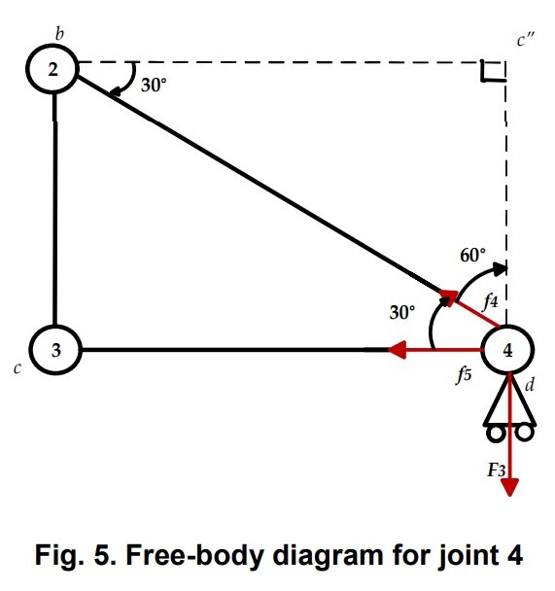


Joint 4 (Resolution of Forces)
Force is a Vector
Forces downward and to the left are taken as negative
Forces upward and to the right are taken as positive

Slide 30
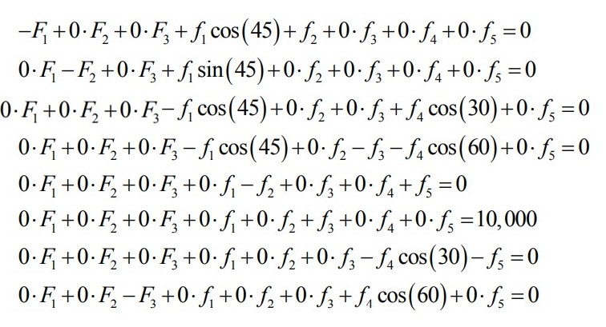
System of Equations

Slide 31
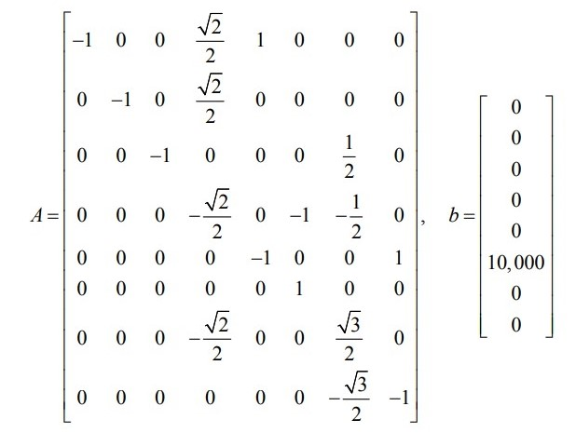
System of Equation in Matrix Form
Row 7 Swap With Row 8
Row 3 Swap With Row 7

Slide 32

Next Step:
Initial Guess = $\left[\begin{matrix}1 & 1 & 1 & 1 & 1 & 1 & 1 & 1\end{matrix}\right]$
$TOL = 0.001$
If $\frac{norm(x_{new}– x_{old})}{norm\left(x_{new}\right)}$ $< TOL$ *Another type of stopping condition, earlier was norm($x_new – x_old$)
Number of Guessed Iterations: $35$

Slide 33


Final Result
Number of Iterations Needed: $30$
$$F_{1}=7.91963092e+00 \\ F_{2}=−6.33684782e+03 \\ F_{3}=−3.65858021e+03 \\ f_{1}=−8.96812187e+03$$
$$f_{2}=6.34476570e+03 \\ f_{3}=1.00000000e+04 \\ f_{4}=−7.31716158e+03 \\ f_{5}=6.33684681e+03$$

Slide 34

Additional Information
The Frobenius norm, sometimes also called the Euclidean norm (a term unfortunately also used for the vector -norm), is
Stopping Conditions
Norms of Matrix
A few different stopping conditions 1. Forbenius norm of $\left(x_{new}−x_{old}\right)<TOL$ 2. $\frac{\text{Forbenius} \text{norm} \text{of}\left(x_{new}−x_{old}\right)}{\text{Forbenius} \text{norm} \text{of}(x_{new})}<TOL$ 3. For each and every row $i$ where $i=1,2…,n$
$x_{i}^{k+1}−x_{i}^{k}<TOL$ only up to n significant figures / decimal places
Vector norms to measure the length of a vector, and we will develop matrix norms to measure the size of a matrix. https://www.sciencedirect.com/topics/mathematics/matrix-norm
Matrix norm is a vector norm in a vector space whose elements (vectors) are matrices (of given dimensions)
Forbenius norm, sometimes also called the Euclidian norm is a matrix norm of an m x n matrix defined as the square root of the sum of the absolute square of it’s elements https://mathworld.wolfram.com/Norm.html
The infinity-norm of a square matrix is the maximum of the absolute row sums

Slide 35
END OF PRESENTATION

